Slide 1
Linked Lists

Slide 2
Linked List Basics
Linked lists and arrays are similar since they both store collections of data.
Arrays allocate memory for all elements at the same time and in one block of memory.
Linked lists allocate memory for each element separately and only when necessary.

Slide 3
Disadvantages of Arrays
The size of the array is fixed.
  In case of dynamically resizing the array from size S to 2S, we need 3S units of available memory.
  Programmers allocate arrays which seem "large enough” This strategy has two disadvantages: (a) most of the time there are just 20% or 30% elements in the array and 70% of the space in the array really is wasted. (b) If the program ever needs to process more than the declared size, the code breaks.
Inserting (and deleting) elements into the middle of the array is potentially expensive because existing elements need to be shifted over to make room

Slide 4
Linked lists
Linked lists are appropriate when the number of data elements is unpredictable.
Linked lists are dynamic, so the length of a list can increase or decrease as necessary.
Each node does not necessarily follow the previous one physically in the memory.
Linked lists can be maintained in sorted order by inserting or deleting an element at the proper point in the list.

Slide 5
Pointers and Linked Lists
To represent linked lists we will use pointers.
Pointer: also called as link or reference, is a variable that gives location of some other variable.
Linked List: For every element in the list, we put a pointer into the element giving the location of the next element in the list.

Slide 6
Single Directional Linked Lists
(Singly Linked Lists)
next
next
next
next
a
b
c
d
First node
Last node

Slide 7
Empty List
Empty Linked list is a single pointer having the value of NULL.
  first = NULL;
first

Slide 8
Implementation of Linked Lists
Using Arrays
typedef struct linkedList{
char data[5];
int next;
}SIMPLE_LIST;
//This list has at most 100 elements
SIMPLE_LIST L[100];
int first = -1; //Index of the first element
int last = -1; //Index of the last element

Slide 9
Implementation of Linked Lists
Using Pointers
typedef struct linkedList{
char data[5];
struct linkedList *next;
}SIMPLE_LIST;
//This list has any number of elements
//Pointers to the first and last elements
// Initially, the list is empty
SIMPLE_LIST *first = NULL;
SIMPLE_LIST *last = NULL;

Slide 10
Basic Linked List Operations
Define the List
Insert a node
List Traversal
Searching a node
Delete a node

Slide 11
Definition of the List
typedef struct linkedList{
int info;
char message[100];
struct linkedList *next;
}SIMPLE_LIST;
// Initially, the list is empty
SIMPLE_LIST *first = NULL;
SIMPLE_LIST *last = NULL;

Slide 12
Insert a new element at the end
1
…
6
first
last
7
last->next = p;
p->next = NULL;
last = p;
What happens if the list is empty?
first = p;
last = p;
p->next = NULL;
p

Slide 13
Insertion function
int insert(SIMPLE_LIST *p){
if (first != NULL){
last->next = p;
p->next = NULL;
last = p;
}
else {
first = p;
last = p;
p->next = NULL;
}
return 0;
}

Slide 14
Traversing a linked list
int displayList(){
SIMPLE_LIST *p
p = first;
if (p == NULL){
printf("List is empty\n");
return -1;
}
while (p != NULL){
printf(" %d %s \n",
p->info, p->message );
p = p->next;
}
return 0;
}

Slide 15
Searching a node in a linked list
// Use sequential search
// Search until target is found or we reach
// the end of list
SIMPLE_LIST *search(int key){
SIMPLE_LIST *p;
p = first;
while (p){
if (p->info == key)
return p;
p = p->next;
}
return NULL;
}

Slide 16
Deletion from a linked list
Search for the element to be deleted.
if it is the first element
if the list has just one element:
1
first last p
// Empty the list
first = NULL;
last = NULL;
free(p);

Slide 17
Deletion from a linked list
if it is the first element
if the list has more than one element:
1
2
3
first p
last
first = p->next;
free(p);

Slide 18
Deletion from a linked list
if it is in the middle or last
find the previous element, and update the pointers
…
5
6
7
…
previous
p
previous->next = p->next;
free(p);
if (p == last)
last = previous;

Slide 19
Deletion function
  SIMPLE_LIST *delete(int key){
  SIMPLE_LIST *p, *previous;
  p = first;
  previous = NULL;
  // search for the element to be deleted
  while (p){
  if (key == p->info)
  break;
  previous=p;
  p=p->next;
  }

Slide 20
Deletion function (cont.)
if (p != NULL){ //if found
if (previous == NULL){
// if first element will be deleted
if (first == last){
// if list has one element
first = NULL;
last = NULL;
}
else {
first = first->next;
}

Slide 21
Deletion function (cont.)
else{
//delete from middle or last
previous->next = p->next;
if (previous->next == NULL){
//last element is deleted
last = previous;
}
}
free(p);
return(p);
}
else //not found
return NULL;
}

Slide 22
Doubly Linked Lists
first
last
1
2
3
Advantages:
Convenient to traverse the list backwards.
Simplifies insertion and deletion because you no longer have to refer to the previous node.
Disadvantage:
Increase in space requirements.

Slide 23
Definition of the list
typedef struct doubly_list{
int info;
char message[100];
struct doubly_list *previous;
struct doubly_list *next;
}DLIST;
DLIST *first = NULL;
DLIST *last = NULL;

Slide 24
Insertion
if the list is empty
first
p
last
first = p;
last = p;

Slide 25
Insertion (cont.)
last
p
// insert at the end
last->next = p;
p->previous = last;
p->next = NULL;
last = p;

Slide 26
Insertion function
int insert(DLIST *p){
if (first != NULL){ // if list is not empty
last->next = p;
p->previous = last;
p->next = NULL;
last = p;
}
else { // if list is empty
first = p;
last = p;
first->previous = NULL;
last->next = NULL;
}
return 0;
}

Slide 27
Display the list on screen
int display(){
DLIST *p;
p = first;
if (p == NULL){
printf("List is empty\n");
return -1;
}
while (p){
printf("%d %s\n", p->info, p->message);
p = p->next;
}
return 0;
}

Slide 28
Search an element from the list
DLIST *search(int key){
DLIST *p;
p = first;
while (p){
if (key == p->info)
return p;
p = p->next;
}
return NULL;
}

Slide 29
Deleting an element
Search for the element to be deleted.
If it is found
  If it is the first element
    If the list has only one element
      Empty the list
    Else
      Delete the first element, and update first
  Else
    If it is in the middle, delete from middle
    Else, delete from last element

Slide 30
Deleting the first element
if the list has only one element, empty the list
first
p
last
first = NULL;
last = NULL;
free(p);

Slide 31
Deleting the first element
if the list has more than one element, update first
p
first
last
first = p->next;
first->previous = NULL;
free(p);

Slide 32
Deleting from middle
p
p->previous->next = p->next;
p->next->previous = p->previous;
free(p);

Slide 33
Deleting the last element
first
last
p
last = p->previous;
last->next = NULL;
free(p);

Slide 34
Deletion function
DLIST *delete(int key){
DLIST *p;
p = search(key);
if (p==NULL){
printf("The element to be deleted is not
in the list\n");
return NULL;
}
if (p == first){ //Delete the first element
if (first == last){ // list has 1 element
first = NULL;
last = NULL;
}

Slide 35
Deletion function (cont.)
else { // list has more than one element
first = p->next;
first->previous = NULL;
}
}
else{
if (p == last){ //Delete from last
last = p->previous;
last->next = NULL;
}
else { //Delete from middle
p->previous->next = p->next;
p->next->previous = p->previous;
}
}
free(p);
return p;
}

Slide 36
Saving and Restoring a Linked List by Using a File
Use an external file to preserve the list
Do not write pointers to a file, only data
For each element in the list
  Copy the element into a file
Recreate the list from the file by placing each item at the end of the list
For each element in the file
  Insert the element at the end of the list

Slide 37
Saving a list in a file
int store(){
FILE *fp;
DLIST *p;
// open the file
if ((fp=fopen("list.txt","w"))==NULL){
printf("File cannot be opened, disk is full\n");
return -1;
}
p = first;
while (p){
fwrite(p, sizeof(DLIST)-2*sizeof(p), 1, fp);
p = p->next;
}
printf("List was stored\n");
fclose(fp);
return 0;
}

Slide 38
Comparing Arrays and Pointer-Based Implementation of Linked Lists
Size
  Increasing the size of a resizable array can waste storage and time
Storage requirements
  Arrays require less memory than a pointer-based linked list

Slide 39
Comparing Arrays and Pointer-Based Linked List Implementations
Access time
  Array: constant access time
  Pointer-based: the time to access the i^{th} node depends on i
Insertion and deletions
  Arrays: require shifting of data
  Pointer-based: require a list traversal

Slide 40
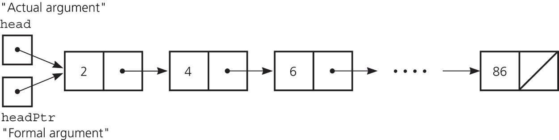
Passing a Linked List to a Function
A function with access to a linked list’s first pointer has access to the entire list
Pass the first pointer to a function as a reference argument
first
firstPtr

Slide 41
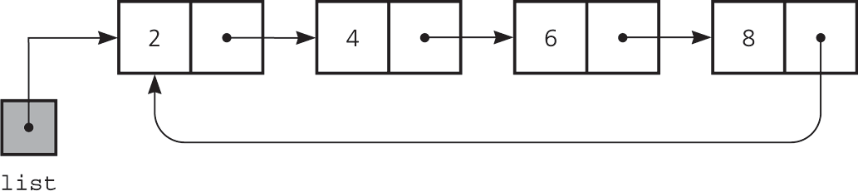
Circular Linked Lists
Last node references the first node
Every node has a successor
No node in a circular linked list contains NULL
first
A circular linked list

